Slide 1

Section B Chat Analysis

Slide 2
Section B App
Problems
Lack of chat analysis options that try accommodate outside the chat interactions
Many chat analysis options either monitor low level information of very large groups or deep level analysis of one-on-one interactions
Someone remote from the group wants to determine what is going on while they aren’t there
Solution
Chat analysis app that analyzes medium sized highly interactive groups of people
Metrics that identify persons, positions, and power outside of the chat
Allows input of external data
Where we are now
Several metrics built off 4 years (2 chats for 2 years) of high level interaction
Dynamic code intake for multiple types of devices
Future Deliverables
Features
Growth Plan
Sentiment analysis
Personality identification
Drive user adaption by offering free analytics to close knit cohorts (future MBA classes)
Expand to international universities within Catalonia/Spain

Slide 3
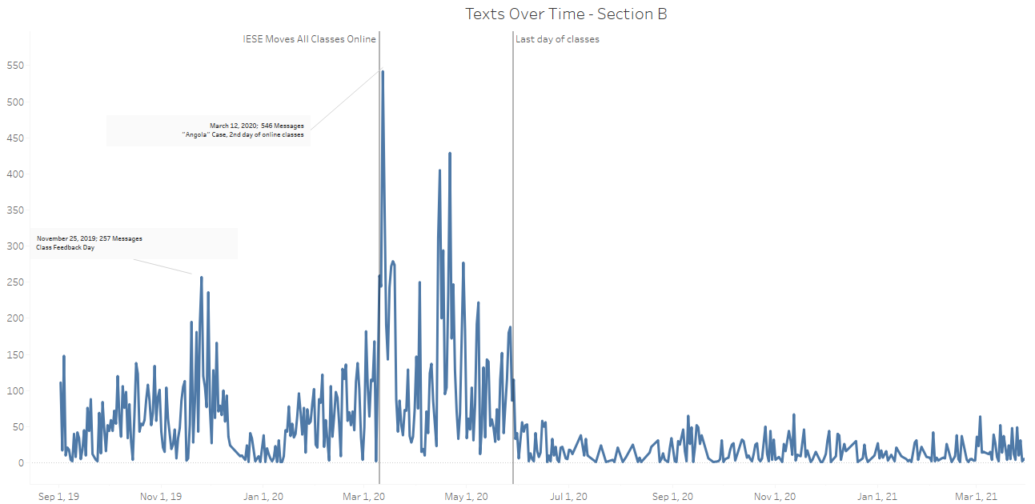
Texts over time

Slide 4
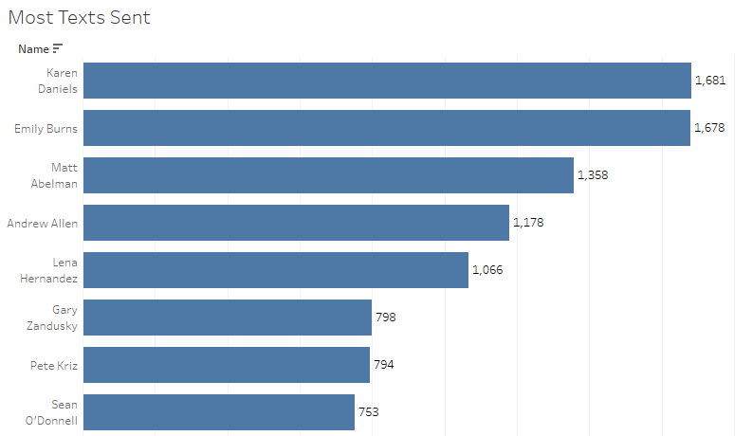
Most texts sent

Slide 5
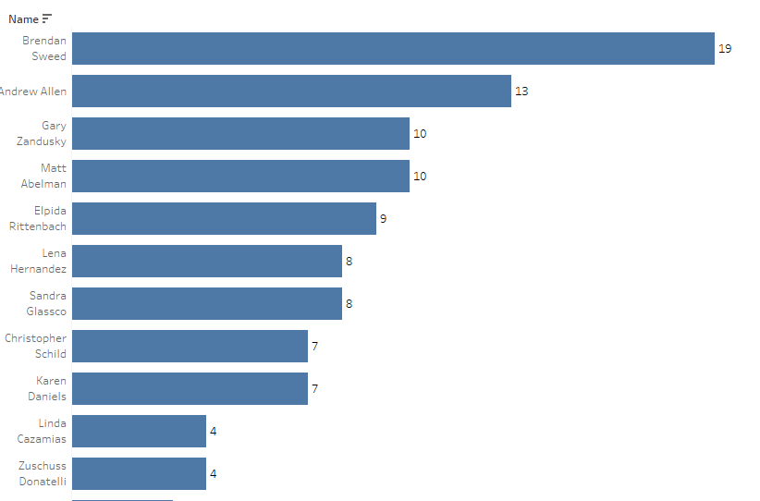
Most texts 2-5AM

Slide 6
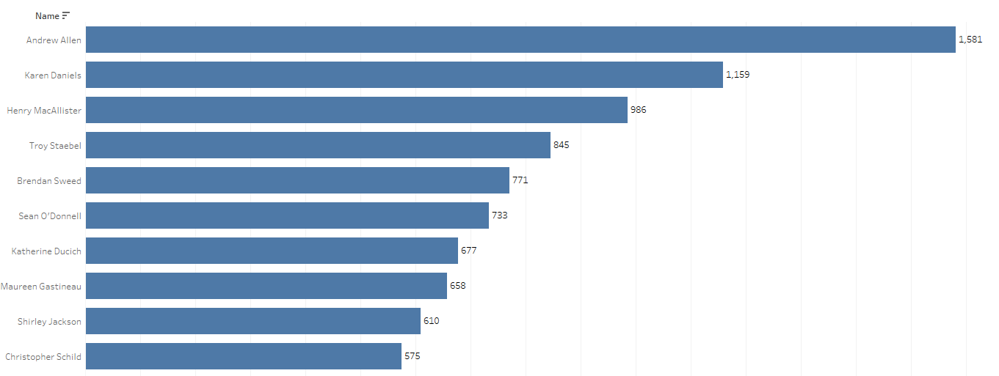
Longest Message

Slide 7
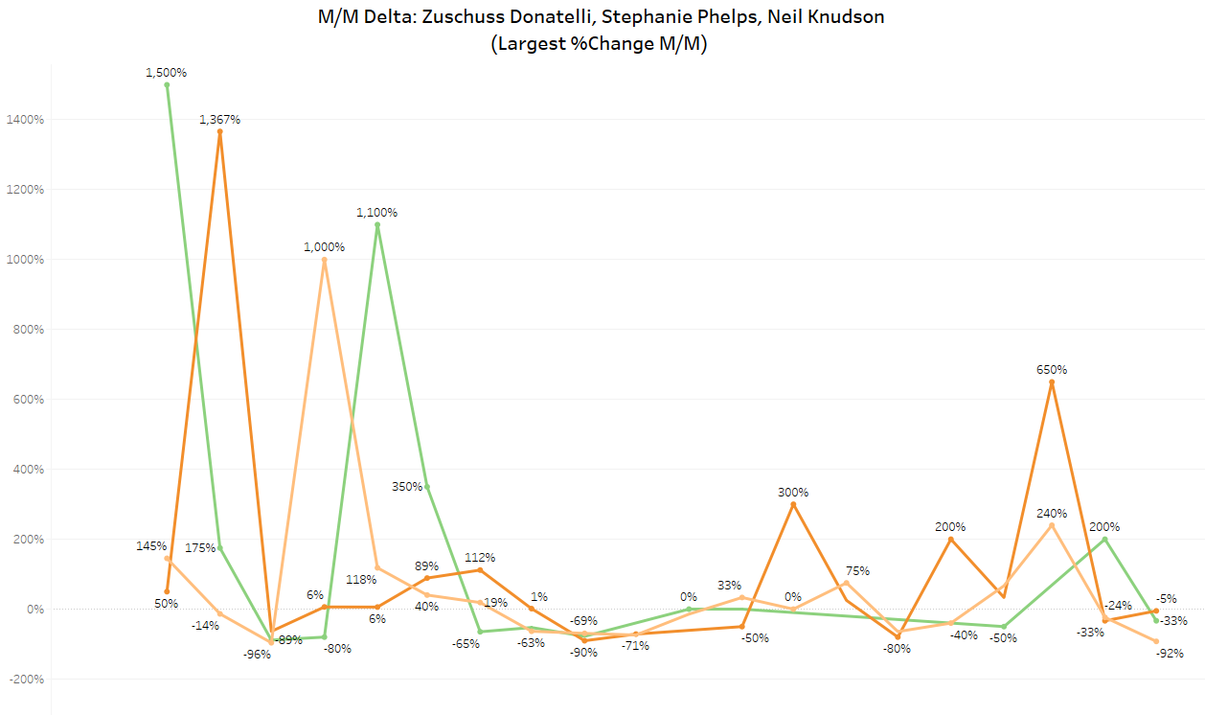
“they only talk to me when they need me”
Largest total M/M change in participation

Slide 8
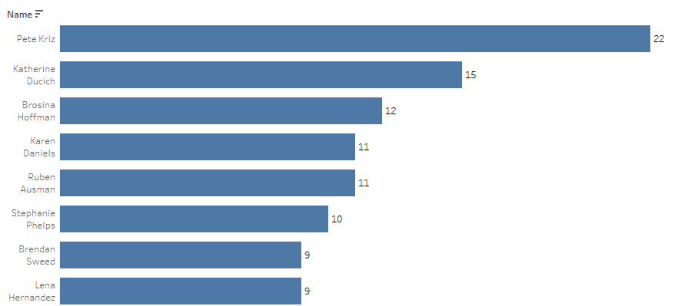
Most deleted Messages

Slide 9
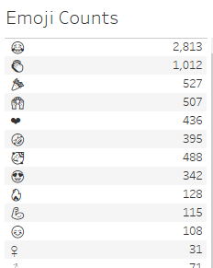
Most Popular Emojis

Slide 10
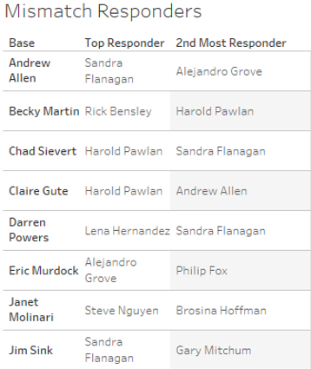
Mismatch Responders

